Slide 1


Web Study Jams - Session 2

Slide 2
Recap
HTML
html
head
body
styles
id , classes
CSS
selectors

Slide 3
DOM
margin
border
padding
content

Slide 4
Javscript Basics
include in src
console.log
conditionals
Loops
declaration
functions

Slide 5
Javscript DOM interaction
Document :
getElementById
createElement
Node :
appendChild
removeChild

Slide 6
Javscript Events
on()
click()
onload()

Slide 7
Javscript Advanced Concepts
function syntax differences - 3 types
callbacks
namespace

Slide 8
Stop !!!!!
Nuff theroy
Let's do something cool

Slide 9
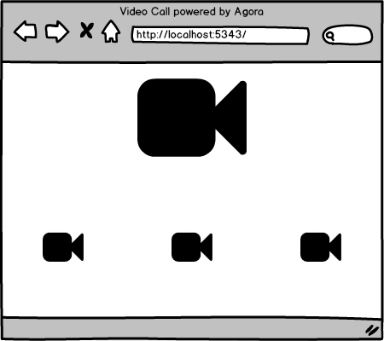
Video Chat platform

Slide 10
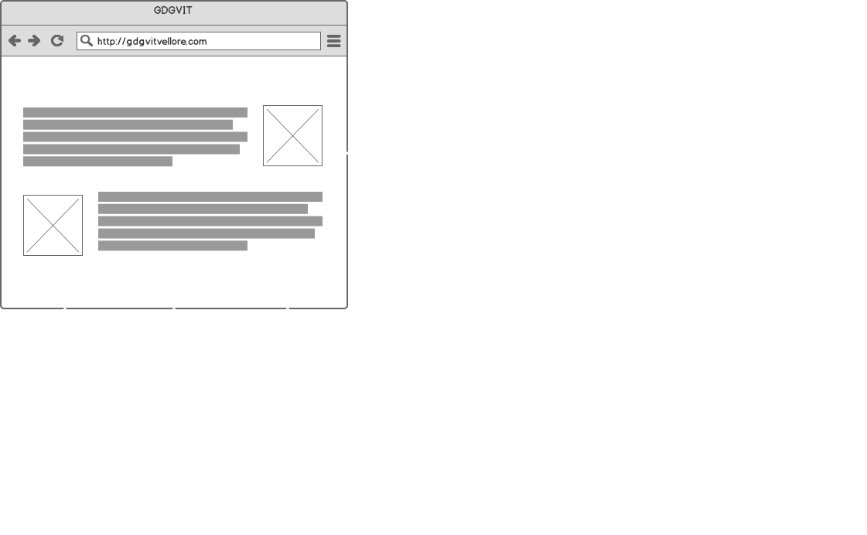
Video Chat platform
Agora API

Slide 11
Get Started
1)Signup for the SDK
https://dashboard.agora.io/
2)Clone the boiler plate
https://github.com/GDGVIT/WebStudyJams

Slide 12
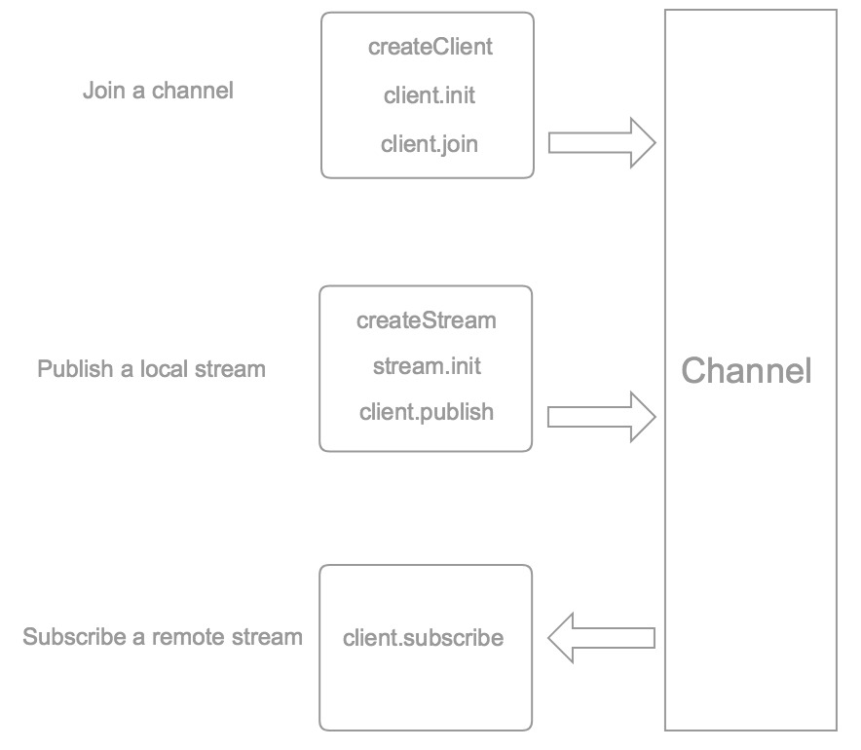
Video Chat platform

